Slide 1
Successes, Solutions, and Similarities: Ways to Maximize Use of Timely Data
12/07/2022
Notes:
Introductions here, DE, IH staff

Slide 2
Agenda
Review examples illustrating data in action
Identify patterns across examples
Elicit and discuss best practice

Slide 3
Strengths of Syndromic Surveillance
Tracks geographic spread
Identifies high-risk groups
Allows for timely public health intervention
Informs policy decisions
Demonstrates symptom development or changes
Monitors individual cases of reportable diseases
Validates or refutes suspicion of outbreaks
Supports traditional surveillance
Detects peaks and assesses magnitude
Often the only available resource

Slide 4
Modern Examples of Timely Syndromic Surveillance Methods in Action Disclaimer: The following examples are publicly available and /or provided by fellow colleagues. We would like to thank them for their work and are proud to highly their efforts in this presentation.

Slide 5
Example 1: Rocky Mountain Spotted Fever (RMSF)
Brown Dog Tick on reservation
Limited Medical Resources
Hx of Missing Dx Created an ESSENCE
Alert To Catch Potential RMSF Situations & reviewed daily
Local epidemiologists identified a patient who met criteria and was transferred
Medical records indicated the patient had improved on doxycycline but was scheduled for discharge without completing the recommended treatment
Local epidemiologist identified this gap and recommended treatment plan be updated accordingly before discharge.
RMSF is not locally-acquired in Maricopa County, thus not immediately suspected
https://www.cdc.gov/nssp/success-stories/AZ-RMSF.html
Notes:
Local example #1 – KC
On June 8, 2018, ESSENCE flagged a suspected RMSF case, an infant who had been transferred to a Maricopa County hospital on June 6. The medical records indicated he was scheduled for discharge within hours of being flagged in ESSENCE. The infant had progressively improved on doxycycline, however, the medical records indicated he would be discharged without completing the CDC-recommended treatment (5–7 days of doxycycline for uncomplicated cases).⁴ MCDPH identified this gap and promptly advocated for continuation of treatment, a potentially life-saving intervention.
Brown Dog Tick on reservation; Limited Medical Resources; Based on History of Missing Dx Created an ESSENCE Alert To Catch Potential RMSF Situations
ESSENCE flagged suspected RMSF case in Maricopa County, Arizona
Medical records indicated the patient had improved on doxycycline but was scheduled for discharge without completing the CDC-recommended treatment
Local epidemiologist identified this gap and pushed for the continuation of treatment before discharge

Slide 6
Example 1: Rocky Mountain Spotted Fever
Trained the system to alert on known situation that needed action
Developed Protocol for when alerted
Followed the protocol
Took swift action to use timeliness as advantage
Notes:
Syndromic surveillance (SyS) can complement public health protocols that rely on passive surveillance methods.
Traditional passive surveillance relies on health care providers with time and resources to send timely reports through proper channels, which could delay communication of health information.
Timely surveillance methods gives them the option to actively review near real-time hospital visit data for conditions of public health concern and identify patients not reported to the health department.

Slide 7
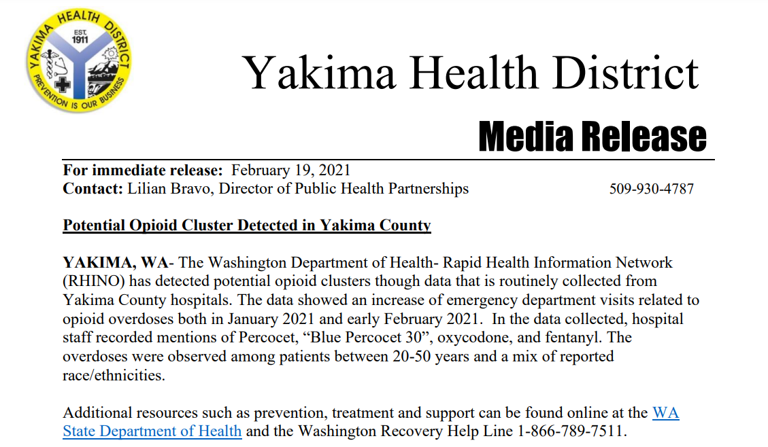
Example 2: Opioid Overdose in Yakima County, WA
Increase of emergency department visits related to opioid overdoses both in January 2021 and early February 2021.
Hospital staff recorded mentions of Percocet, “Blue Percocet 30”, oxycodone, and fentanyl.
The overdoses were observed among patients between 20-50 years and a mix of reported race/ethnicities.
A press release was distributed to inform the community and requested pharmacies to dispense Narcan to patrons at risk.
The Washington Department of Health- Rapid Health Information Network detected potential opioid clusters through data that is routinely collected from Yakima County hospitals.
https://www.yakimacounty.us/DocumentCenter/View/27171/02192021_Opioid-Clusters?bidId=
Notes:
https://www.yakimacounty.us/DocumentCenter/View/27171/02192021_Opioid-Clusters?bidId=
https://komonews.com/news/local/overdose-deaths-on-the-rise-at-start-of-2021 <- puts the ED info together with deaths

Slide 8
Example 2: Opioid Overdose in Yakima County, WA
Trained the system to alert on known situation that needed action
Validated cluster and characterized those most at risk
Developed Protocol for when alerted
Followed the protocol
Communicated with partners and community
Notes:
Syndromic surveillance (SyS) can complement public health protocols that rely on passive surveillance methods.
Traditional passive surveillance relies on health care providers with time and resources to send timely reports through proper channels, which could delay communication of health information.
Timely surveillance methods gives them the option to actively review near real-time hospital visit data for conditions of public health concern and identify patients not reported to the health department.

Slide 9
Example 3: Synthetic Marijuana in the Midwest, 2018
Hospital Follow-Up & Poison Control/Law Enforcement Partnerships
Spatial
Cluster
&
Symptom Identification
Follow-Up & Partnerships
Public
Health Intervention
Poison
Control Notification
Syndrome Definition Development and Utilization
https://vimeo.com/268054178
Notes:
https://ojphi.org/ojs/index.php/ojphi/article/view/9937/8038 – IL
https://ojphi.org/ojs/index.php/ojphi/article/view/9896/8003 - MD
https://www1.nyc.gov/assets/doh/downloads/pdf/han/advisory/2018/advisory-7-k2.pdf – NYC surveillance

Slide 10
Example 3: Synthetic Marijuana in the Midwest, 2018
Public Health Intervention
Syndromic was most valuable early on as hospitals weren’t aware, thus not reporting
Allowed HD to review line lists and properly communicate with the hospitals and set up more traditional reporting methods.
Eventually had the product tested and found brodifacoum (chemical in rat poison)
Treatment is long term and expensive – Vitamin K
Put out alerts for the public and had product removed
https://vimeo.com/268054178
Notes:
https://ojphi.org/ojs/index.php/ojphi/article/view/9937/8038 – IL
https://ojphi.org/ojs/index.php/ojphi/article/view/9896/8003 - MD
https://www1.nyc.gov/assets/doh/downloads/pdf/han/advisory/2018/advisory-7-k2.pdf – NYC surveillance

Slide 11
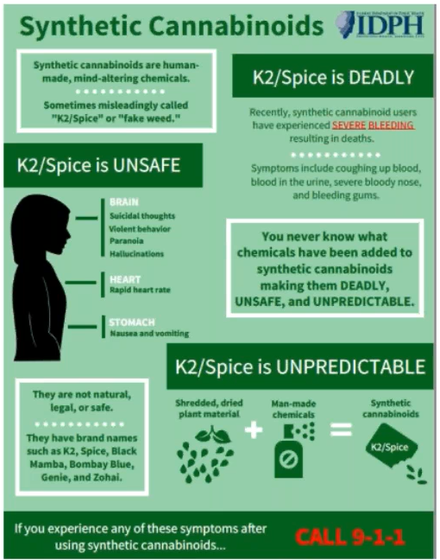
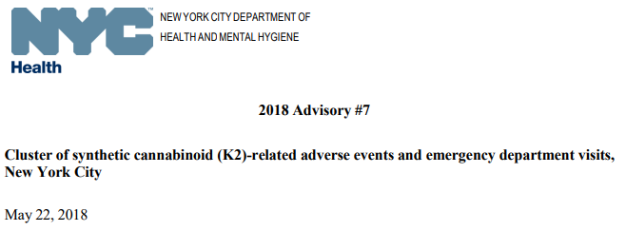
https://vimeo.com/268054178
https://www1.nyc.gov/assets/doh/downloads/pdf/han/advisory/2018/advisory-7-k2.pdf

Slide 12
Example 3: Synthetic Marijuana in the Midwest, 2018
Confirmed suspicion of wider problem
Alerted hospitals
Developed more traditional reporting from sys information
ID’d probable cases
Characterized who was at risk
Put out communications to community and partners
Took products off the shelves
Notes:
Syndromic surveillance (SyS) can complement public health protocols that rely on passive surveillance methods.
Traditional passive surveillance relies on health care providers with time and resources to send timely reports through proper channels, which could delay communication of health information.
Timely surveillance methods gives them the option to actively review near real-time hospital visit data for conditions of public health concern and identify patients not reported to the health department.

Slide 13
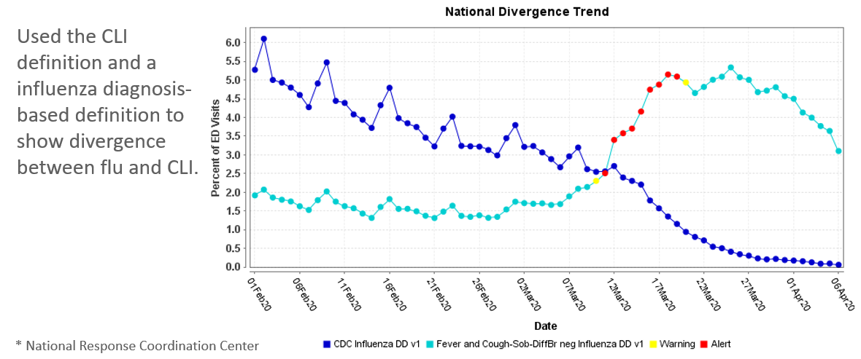
Example 4: COVID
Epis used an overlay of symptom-based queries (difficulty breathing, loss of taste and smell, etc.) with Flu ICD codes.
When flu dx decreased, but symptoms stayed – it was likely COVID
Beginning of the pandemic - tests not widely available
https://vimeo.com/410751579
Notes:
Symptom development picture
Beginning of the pandemic – no test, not sure if here, generic symptoms
Used overlay of symptom based query (difficulty breathing, loss of taste and smell, etc.) with Flu ICD codes. When flu decreased, but symptoms stayed – we knew we likely had COVID

Slide 14
Example 4: COVID
With little to no other data available, Creatively used information that was available to develop deeper understanding
Notes:
Syndromic surveillance (SyS) can complement public health protocols that rely on passive surveillance methods.
Traditional passive surveillance relies on health care providers with time and resources to send timely reports through proper channels, which could delay communication of health information.
Timely surveillance methods gives them the option to actively review near real-time hospital visit data for conditions of public health concern and identify patients not reported to the health department.

Slide 15
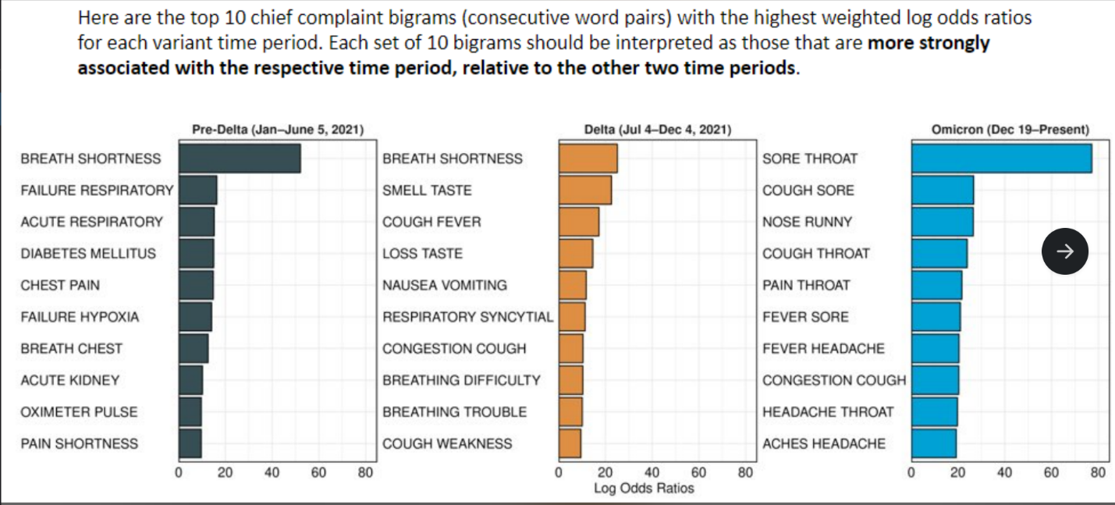
Example 4: COVID
In subsequent surges, were trying to inform severity, opening society, and mask rules. NSSP staff were able to show changes in severity of language in Chief Complaints using near real time data along with historical data. Confirming anecdotal thoughts about the changing severity.
https://vimeo.com/681405538
Notes:
Symptom development picture

Slide 16
Example 4: COVID
Applied novel analysis techniques
Used flexible text to better understand characteristics
Informed understanding of severity – implications for policies
Notes:
Syndromic surveillance (SyS) can complement public health protocols that rely on passive surveillance methods.
Traditional passive surveillance relies on health care providers with time and resources to send timely reports through proper channels, which could delay communication of health information.
Timely surveillance methods gives them the option to actively review near real-time hospital visit data for conditions of public health concern and identify patients not reported to the health department.

Slide 17
Example 5: E-cigarette/Vaping, product use Associated Lung Injury - EVALI
Unusual cluster of lung injuries reported by clinicians to state health departments - WI + IL report cluster
Clear need for a way to…
1) rapidly characterize the event
2) Understand the spread
3) Determine cause and risk factors
Initial efforts used timely syndromic data to cast a wide net
Traditional interviews were conducted to get more details.
The information from those interviews was used to improve syndromic definitions and identify more cases.
More interviews and clinical chart reviews were done
These interactions helped determine who was at risk, probable causes, comms went out around risk factors, and products were removed
Notes:
Electronic cigarette (e-cigarette), or Vaping, product use–Associated Lung Injury (EVALI) was a very rare, sudden, dangerous, and unexpected event. There were no codes for it and only anecdotal reports.
Because of the timeliness and flexibility of syndromic surveillance, CDC in collaboration with local health departments was able to confirm anecdotal reports using existing data, make adjustments to definitions in real time, describe who was at risk and how widespread this phenomenon was within just a couple of weeks
https://www.nejm.org/doi/full/10.1056/NEJMsr1915313
https://www.cdc.gov/mmwr/volumes/69/wr/mm6903e2.htm#:~:text=Syndromic%20surveillance%20indicates%20that%20ED%20visits%20related%20to,practitioners%20should%20remain%20vigilant%20for%20new%20EVALI%20cases
.

Slide 18
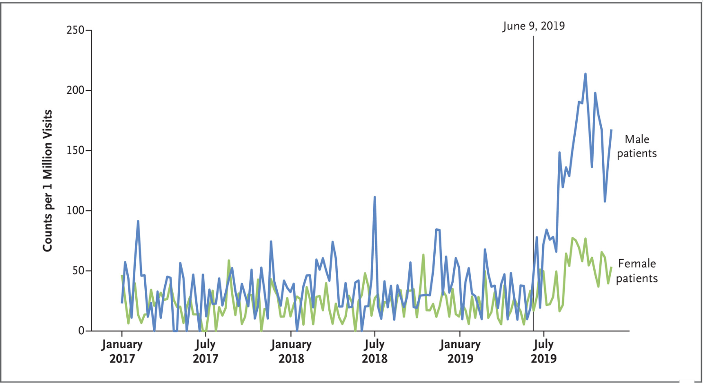
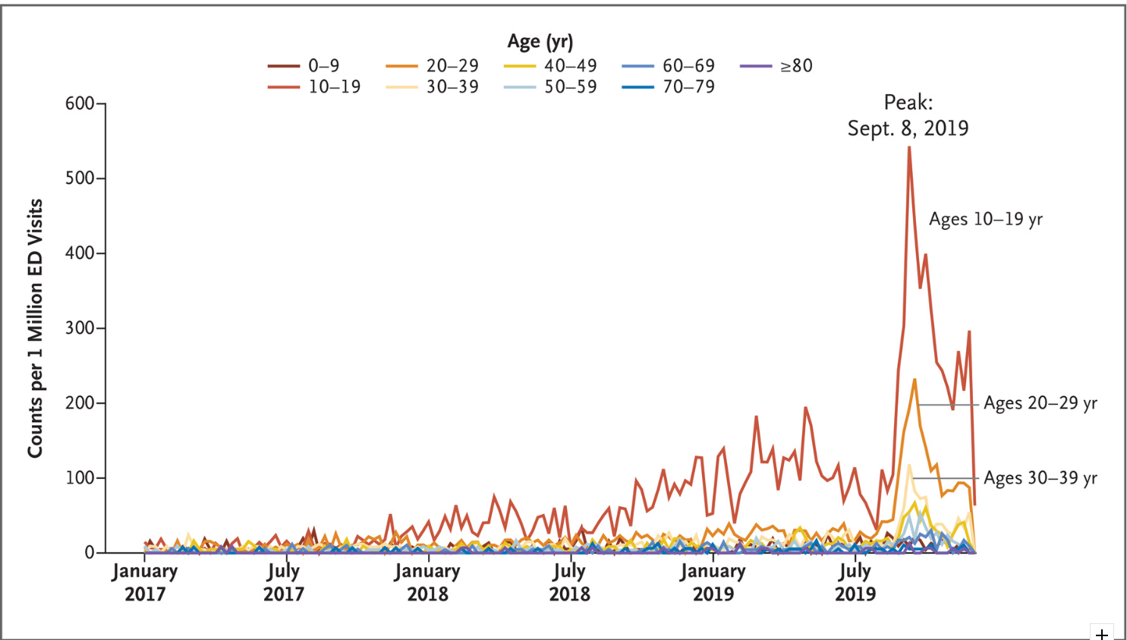
Example 5: EVALI
WI + IL report clusters of severe respiratory illnesses among young adults/adolescents, who reported recent use of electronic
e-cigarettes/vapes
https://www.nejm.org/doi/full/10.1056/NEJMsr1915313

Slide 19
Example 5: EVALI
Used available data to rapidly characterize
Used in conjunction with more traditional interview techniques to understand spread and risk factors
Continued to refine definitions as interview information became available
Communicated with community and partners
Took product off the shelves
Notes:
Syndromic surveillance (SyS) can complement public health protocols that rely on passive surveillance methods.
Traditional passive surveillance relies on health care providers with time and resources to send timely reports through proper channels, which could delay communication of health information.
Timely surveillance methods gives them the option to actively review near real-time hospital visit data for conditions of public health concern and identify patients not reported to the health department.

Slide 20
Example 6: Boston, MA Bike Accidents
In 1998, 1200 pedestrians
transported to local hospitals
(~3 incidents per day)
Observed 122% increase in accidents between 2007-2009
1,411 bike-related injuries visits including outside of Boston zip codes
VS.
768 Bike-related injuries visits for Boston zip code

Slide 21
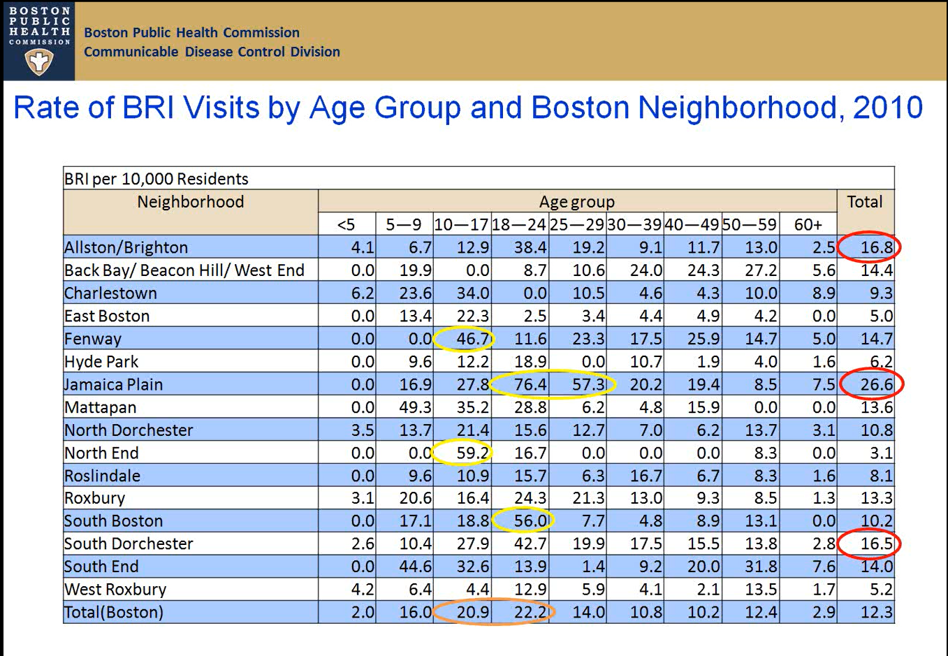
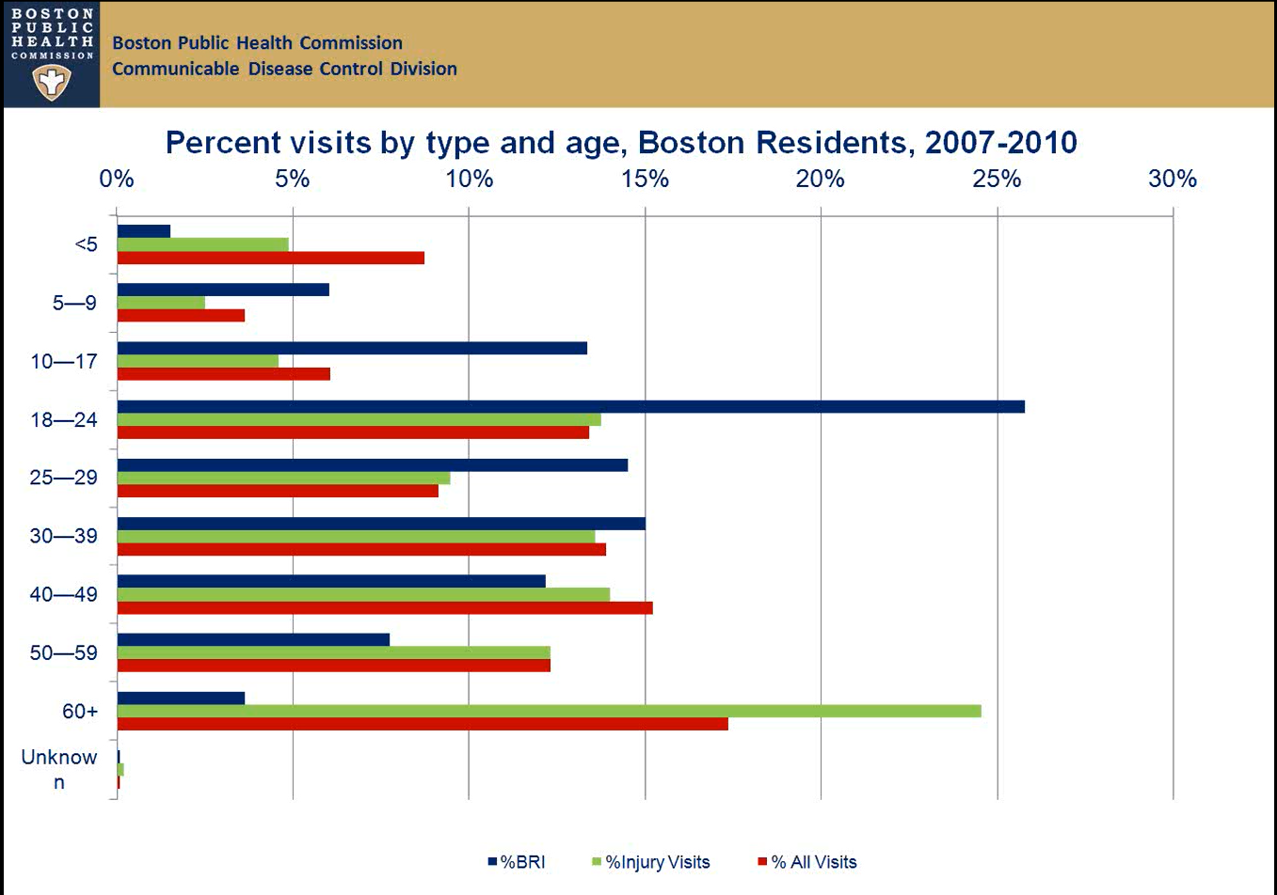
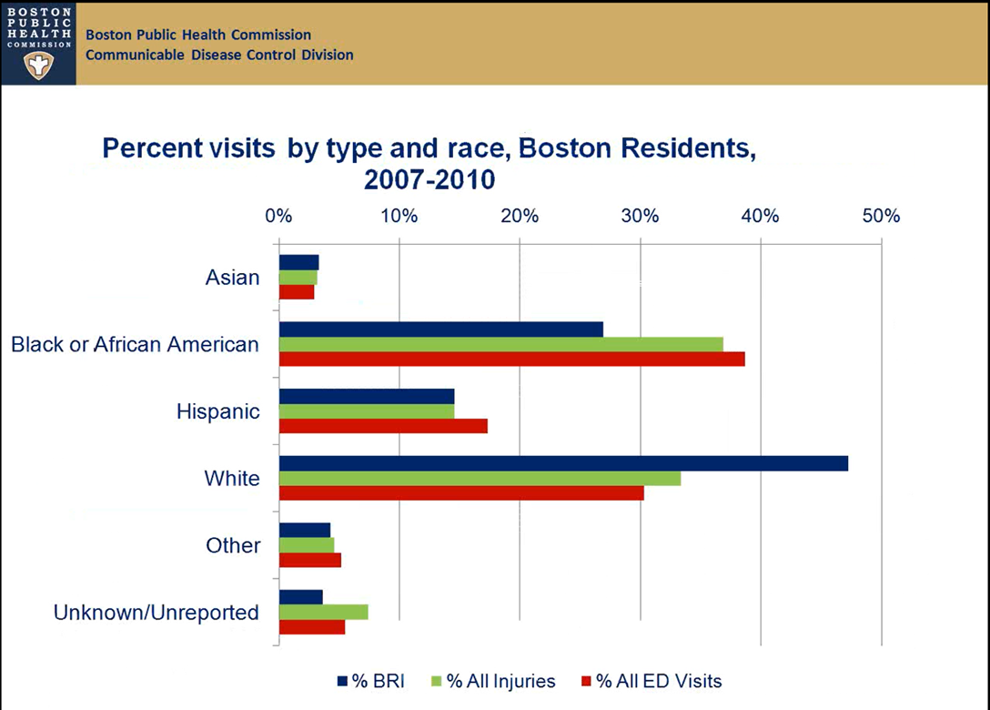
Example 6: Boston, MA Bike Accidents
What does this all tell us?
Bike injuries were highest among:
among out of Boston + out of State;
white, 18-24-year-olds;
3) Allston/Brighton – a predominantly college town.
https://vimeo.com/39649953

Slide 22
Example 6: Boston, MA Bike Accident
Data indicated which population was most at risk, thus education efforts were targeted towards college towns
Data identified which intersections to focus redesign efforts
These targeted interventions can be attributed to the timely and smart use of data in combination that didn’t exist before the use of ED Syndromic methods.

Slide 23
Example 6: Boston, MA Bike Accident
Worked collaboratively with EMS and Community partners
Combined data sets and used all available data (i.e. race and other demographics) to better characterize risk factors
Communicated with community and partners
Identified and worked with partners to change problematic intersection
Notes:
Syndromic surveillance (SyS) can complement public health protocols that rely on passive surveillance methods.
Traditional passive surveillance relies on health care providers with time and resources to send timely reports through proper channels, which could delay communication of health information.
Timely surveillance methods gives them the option to actively review near real-time hospital visit data for conditions of public health concern and identify patients not reported to the health department.

Slide 24
Example 7: Chlorine Gas Exposure in GA Swimming Pools
May 19, 2018
7 patients, aged 10-12 visited 2 different EDs within a 24 min period
May 21, 2018
GA DPH SyS coordinator noticed anomalies in Sys and notified the county’s Board of health
May 22, 2018
Patients reported breathing issues and their parents suspected chemical exposure
The Board of Health epi determined patients had exposure to an unknown gas during a local swim meet
The epi notified the EH county supervisor who followed up with the pool company’s vice president
During an inspection, it was found that there was exposure to chlorine gas and the pool was immediately closed
Follow-up
Staff ensured corrective action was taken by poll company prior to reopening
EH staff educated the pool company on proper and safe management according to county code
https://www.cdc.gov/nssp/success-stories/GA-Chlorine-Gas.html

Slide 25
Example 7: Chlorine Gas Exposure in GA Swimming Pools
Used alerting to identify cluster
Worked across silos across state and local health departments
Performed an investigation
Educated pool owner and all other pool operators
Notes:
Syndromic surveillance (SyS) can complement public health protocols that rely on passive surveillance methods.
Traditional passive surveillance relies on health care providers with time and resources to send timely reports through proper channels, which could delay communication of health information.
Timely surveillance methods gives them the option to actively review near real-time hospital visit data for conditions of public health concern and identify patients not reported to the health department.

Slide 26
The examples highlight key best practices…
Stay alert and astute – don’t become complacent or negative about limitations
1
Set up alerting capabilities for known situations
2
Set up response protocol and follow through when alerted
3
Characterize event & spread – use all data - demographics, etc.
4
Identify and inform probable risk factors, causes, and exposures
5
Perform active case finding
6
Communicate with partners and public – especially with actions to take
7
Be decisive with info you have – Act appropriately - Change environment / perform intervention
8

Slide 27
Summary
I was recently asked – what can we do to help health departments take action?
I’m hoping that these types of reviews of where action was taken will be helpful.
We as public health professionals should guard against watching data go up and down and ask ourselves, “so what?” or “so what now?” – what can be done about what you see in the data?

Slide 28
Final Word
Prerequisites
Input
Define
Investigate
Summarize
Act
Pre-event
Event
Post-event
Don’t let perfection paralyze you
Be curious
Work iteratively
Be creative
Think about how syndromic can support/integrate
Look for gaps that you may be able to fill

Slide 29
Additional Examples

Slide 30
Example 4: COVID
Non-exhaustive ways syndromic has been used for COVID
Identified/ fill-in hospital information
Tracked severity in different populations
Fill in missing case info (e.g., race and ethnicity, occupation, contact information)
Tracked trends
Identified clusters/outbreaks
Tracked ED and hospital utilization
Investigated hospitalizations
Investigated impacts of COVID on mental health and other conditions (e.g.,s MIs)
Tracked, investigated, and identified COVID VAE
Notes:
Lots of articles using NSSP data for COVID here: https://www.cdc.gov/nssp/related-articles-more.html
Description of CDC response using NSSP data: https://www.cdc.gov/nssp/covid-19-response.html#:~:text=Reliable%20data%20from%20syndromic%20surveillance,act%20quickly%20and%20save%20lives.

Slide 31
Example: Hurricane Irma Carbon Monoxide (CO) Poisoning
Observed spike in CO poisoning
CO poisoning disproportionally affecting 10-19 age
group

Slide 32
Example: Hurricane Irma Carbon Monoxide (CO) Poisoning
Observed spike in CO poisoning
CO poisoning disproportionally affecting 10-19 age
group
SyS can be used to identify notifiable conditions that weren’t being reported

Slide 33
Additional SyS Examples Than Time to Describe
Lead Poisoning surveillance in KS
Electric Scooter surveillance in Austin, TX
Firearm Injury surveillance in VA
Monitoring Hurricane Displaced People in TN
Wildfire surveillance in WA
Agriculture Worker Injury surveillance in KS
Heat Dome surveillance in OR
Follow-up Exposure to Bats in multiple states
Identifying Unreported Reportable Conditions in multiple states
https://ojphi.org/ojs/index.php/ojphi/article/view/7695 ; https://communityimpact.com/austin/central-austin/transportation/2019/05/02/cdc-releases-results-of-scooter-study-finds-nearly-half-of-injuries-are-severe/ ; https://www.vdh.virginia.gov/surveillance-and-investigation/syndromic-surveillance/firearm-injury-surveillance/ ; https://www.cdc.gov/nssp/success-stories/TN-Population-Changes.html ; https://knowledgerepository.syndromicsurveillance.org/syndromic-surveillance-monitor-wildfire-events ; https://www.cdc.gov/nssp/success-stories/KS-Agricultural-Workers.html ; https://www.ncbi.nlm.nih.gov/pmc/articles/PMC5676512/) ; https://www.cdc.gov/nssp/success-stories/ks-rabies.html ;

